Slide 1
Hiring Process Analytics
This project is about analyzing data related to hiring and salaries in different departments of a company. The main goals were to look at average salaries offered by each department, the number of males and females hired, and the distribution of employees based on their salary levels. The purpose was to better understand how hiring and salary decisions are made in the company.

Slide 2
Approach:
I used Microsoft Excel to organize and analyze the data. I created charts and tables to:
Calculate the average salary offered by each department.
See how many males and females were hired.
Understand how many people were hired and rejected each month.
Divide employees into salary categories (high, mid, and low) to compare how many males and females are in each group.

Slide 3
Tech-Stack Used:
Microsoft Excel 2022: I used Excel to analyze the data and create graphs and tables to easily understand the information.

Slide 4
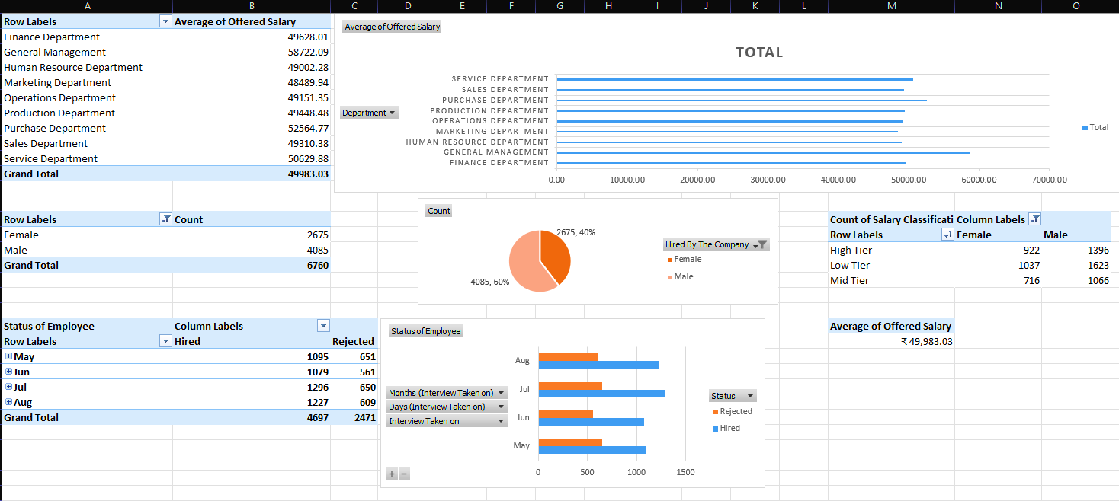
Insights:
The General Management department has the highest average salary, while the Marketing Department has the lowest.
60% of employees hired were males, and 40% were females.
More employees were hired than rejected, but the rejection rate stayed somewhat consistent each month.

Slide 5
Result:
Through this project, I learned about the company’s hiring patterns and salary offers. It helped me see trends, such as which departments offer higher salaries and how hiring decisions differ for males and females.

